Slide 1
2023-2024 Welcome
Year 7 Parental Information Evening

Slide 2
Agenda
Welcome and introduction – Matt Buckley Assistant Principal
Information –Graeme Henderson Head of Year 7
Reviewing questions

Slide 3
Vision for Wye
Continue to be a smaller than average community school that has strong relationships and happy students
A well- behaved school with traditional good manners and respect for people of all backgrounds
Outward facing, using the best of United Learning's experience in private and state schools across England
Students making excellent academic progress, but we are not an exam factory
That Year 11 leave us qualified and ready for their next step
That as many Year 11s as possible have high enough grades to be suitable for further academic study in our 6th Form, or the provider of their choice

Slide 4
Children only get one chance - but are not alone, we will support you all the way to success
'we' = parents and school

Slide 5
Wye Curriculum– Head of Year 7
Wye School is part of United Learning and has the United Learning curriculum at the core so that every student has the same quality of lesson material across the whole of each department.
In Year 7, students' study:
Mathematics
Science
English
History
Geography
Music
Religious Studies
Art
Spanish/French
IT
Games (PE)
Drama
PSHE
Design Technology
Every student has the right to a challenging and enlightening curriculum. By teaching this curriculum well, and developing effective habits in our students, we bring out the best in everyone.
You can view what your child is learning for each half term for each subject on our school website.
https://www.wyeschool.org.uk/secondary-school/curriculum-overview

Slide 6
Setting for core subjects– Head of Year 7
We have used students KS2 information to place them in the best set for our core subjects that will provide the best support.
Over the next couple of weeks, students will all be completing a series of questions that will help us check that these are the most appropriate sets which we will then update in October if any changes are needed.
These questions are on a range of topics such as vocabulary, numeracy, non-verbal reasoning and other skills such as proof-reading. There is no way of revising or preparing for these.
Sets are reviewed every year in the middle of the academic year based on their mid-year assessment, and we will move students between sets as necessary to ensure they receive the most appropriate support.

Slide 7
Homework - Head of Year 7
In year 7, students will receive approximately 25 minutes of compulsory homework for English and Languages per week, and Mathematics which is 60 minutes per week.
This will be set on Satchel One for which both students and parents have a log in. The details of both the hand in dates and the tasks will be found here.
The log-in details were sent home via students on Monday. If there are any issues, contact Heads of year or form tutors a.s.a.p.
Other homework will be set but is non- compulsory.
Sparx English and Maths homework which is not completed will result in students having to attend a catch-up session during the school day. A PPT has been attached to SMHW to help assist students with logging on to Sparx Reader. It is the same login as the maths, just a slightly different link.

Slide 8
Sparx Maths and Reader – Homework - Head of Year 7
All Maths homework will be on the Sparx maths platform and usually aims to take 1 hour per week but this may be less depending on the topics.
There are 3 different types of homework.
A compulsory section that students must complete each week
XP boost – this is optional but students can do this to stretch themselves further and earn more XP
Target questions – this is optional but students can choose to do this to improve questions that they have got wrong in the past.

Slide 9
Sparx Maths Homework
The difficulty of the homework will adapt overtime based on the questions that your child gets right or wrong and the time that they take. Due to this, please do not give the answers to your child, as then it will not be able to adapt appropriately to your child’s ability level.
If students are stuck on a question, there is a short video they can watch to help them with the question.

Slide 10
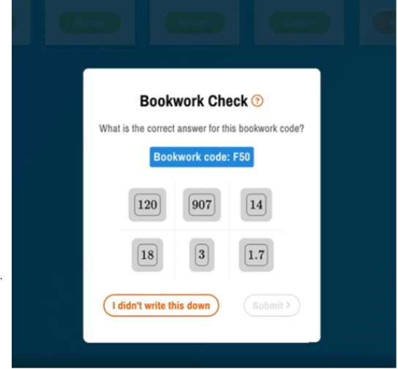
Sparx Maths Homework
Students need to ensure they write the bookwork code for each question as well as the answer in their homework book as it will ask for these again in the future to ensure students are completing their homework fully.

Slide 11
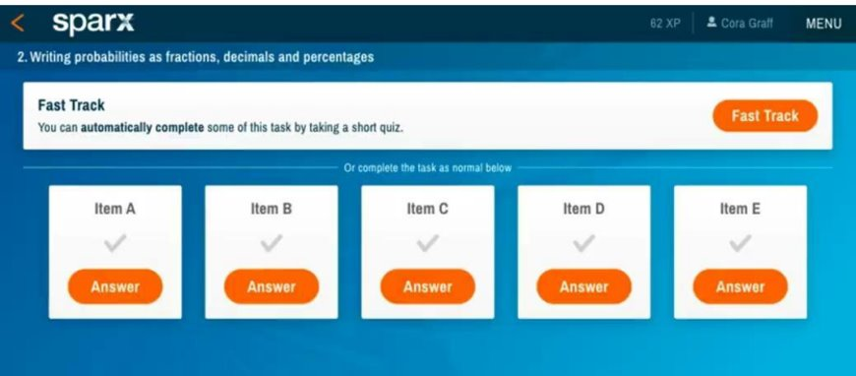
Sparx Maths Homework-Fast Track Feature
This is an optional feature where students can choose to challenge themselves by attempting questions without access to the support videos
Students unlock this feature by completing three home works in a row at 100% completion
If they do well in the quiz they are rewarded with a slightly shorter homework, but the questions are more challenging to stretch and deepen their understanding

Slide 12
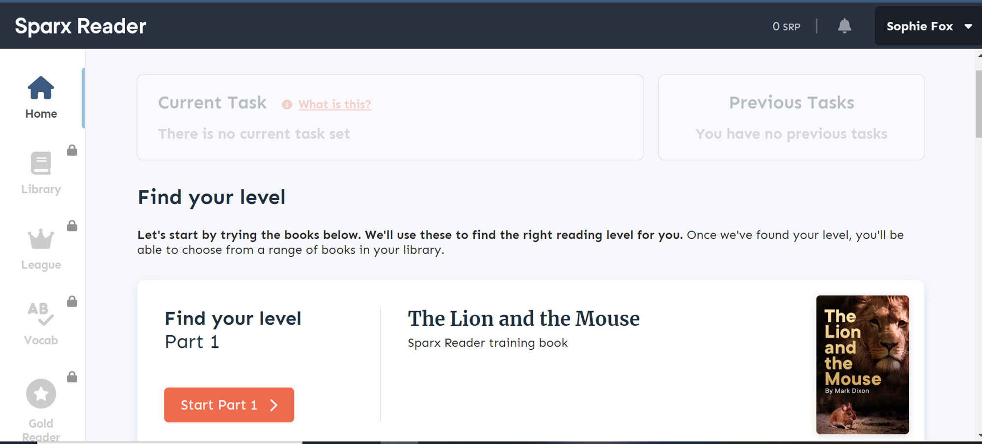
Sparx Reader Homework
All English Homework will be on the Sparx reader platform. Reading is measured in SRP 'Sparx Reader Points' and each week students are set 60 minutes of reading to boost their literacy skills. The more they read, the content made available increases in difficulty.
Students can read more if they wish, outside of the task made available on the screen. To do this, simply click on the 'library' option.

Slide 13
Sparx Reader Homework
Once logged onto Sparx, students will see their first homework has been set (due first on the 19th to allow students time to log on and ask questions if need be.)
They must click on the task to complete and follow the instructions.

Slide 14
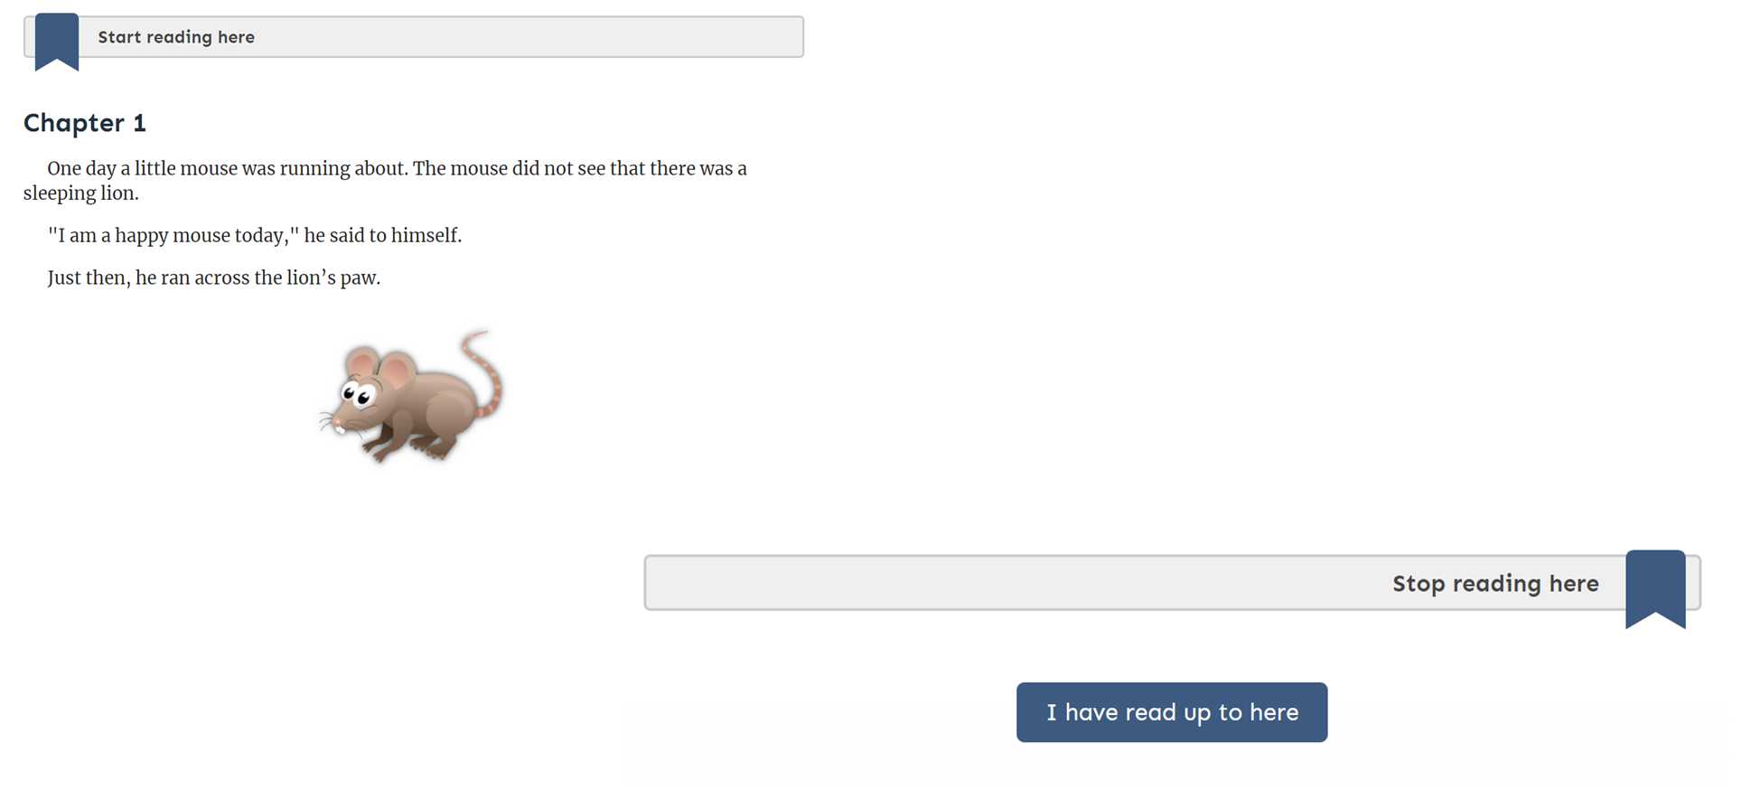
Sparx Reader Homework
For each small section of reading, there will be some questions that follow and a score given at the end.

Slide 15
Reporting and Parent’s Evenings – Head of Year 7
First Year 7 Parents' Evening – Monday 16th October 2023
Second Year 7 Parents' Evening - Thursday 18th April 2024 Crown/ MW
Second Year 7 Parents’ Evening- Wednesday 24th April 2024 Olanteigh/ Stour
School reports are also sent to parents via our parent portal (Arbor) twice per year
Half term 3 and Half term 6
On these reports, you will receive a current grade, target grade and a comment on what topic your child can work on to improve further.
You will also receive an indicator that explains their attitude to learning (e.g. “Excellent” or “Good”).
In Maths, English and Science, you will also be told the rank that your child is in within the year group.
These dates can also be found on the school website

Slide 16
Houses
Houses
Crown
Stour
Olantigh Margret Williams (MW)
Each House will have 2 House Captains per year group
Each House also nominates a House charity who they will fundraise for during the year

Slide 17
Reading
Here at Wye School, we put great importance on regular wider reading inside and outside of English lessons.
In school, our students undertake a regular reading session every Tuesday and Wednesday as part of their tutor time where, alongside their tutor, they access our new wide range of texts, especially purchased for this purpose.
Tutors model the reading first and then students are called upon to read aloud too, following along carefully with a ruler, to encourage confidence and focus. Students will read a new text each term and so will have completed at least six new texts each year.
Outside of school, students should be encouraged to read as much as possible (in a variety of formats) as reading amongst young people has declined due to social media use and this will inevitably affect learning.
In Year 7 tutor time, students will read:

Slide 18
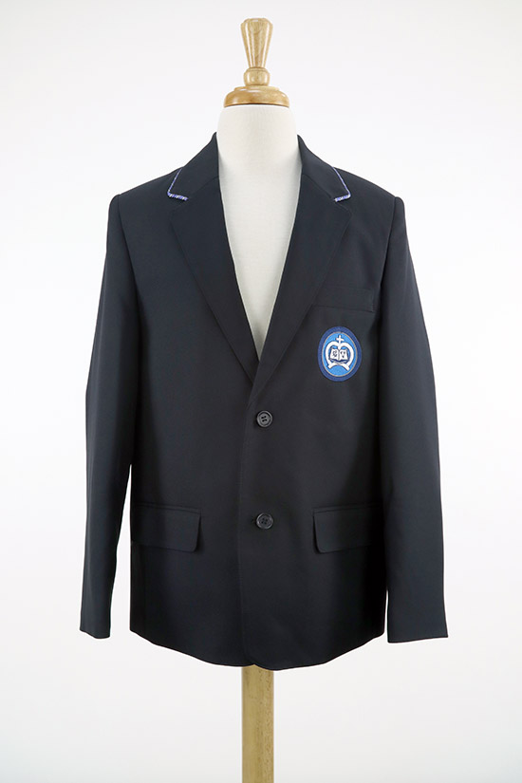
Uniform
Firstly, thank you all for sending your children into Wye School looking so smart! It is always such a pleasure to see our new Year 7 students looking proud in their uniforms on the first day.
As you can imagine, misplacement of uniform items is a common occurrence. To avoid this, all items of uniform should have students' names clearly labelled. Students must wear the correct uniform in the proper way, at all times, including journeys between home and School.
Hair cuts should be smart, and no un-natural hair colours. Single silver or gold studs are permitted in ear lobes only. Nail varnish and/or false nails are not permitted. Shoes must be plain black leather or leather look school shoes. Skirts must be worn as sold. No leggings or tight trousers.

Slide 19
Uniform
A list of all uniform items and PE kit are on our school website.
Winter coats and jackets should be plain in colour with minimal images or logos on them. Outdoor garments must be removed when indoors. Students carry their coats with them during the school day.
The last day of each long term is often a non-uniform day in which we raise money for a chosen charity. Money for charity is collected on the penultimate day of term. Non-uniform must be appropriate for school i.e. no revealing clothing, offensive logos or slogans, no high heels or platform shoes, no false nails.
*Please check the website under the 'parents' tab and scroll down to uniform to check full information on uniform, hair, jewelry and PE Kit.

Slide 20
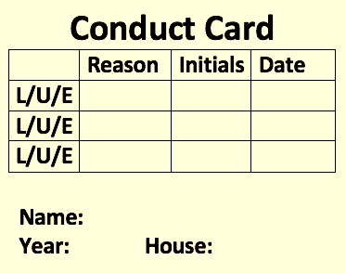
Equipment
Each day, students must have the following equipment:
Black pen
Green pen
Pencil and rubber
Ruler
Compass and Protractor
Scientific Casio Calculator
Highlighter
A reading book
A valid conduct card with a name
White board Pen
All equipment except calculators can be bought in reception at lunchtime or breaktime if needed.
To ensure that our students are responsible for bringing the correct equipment, arrive to lessons promptly and wear the correct uniform, each student has a conduct card.
If your child receives three conduct card signatures for not having any of the above, then they will receive a lunchtime detention and be provided with a replacement conduct card.
Conduct cards that have no signatures will be entered into a raffle draw at the end of term to win prizes.

Slide 21
Expectations and rewards
Our behavior system aims to bring out the best in everyone.
Students are expected to:
Arrive on time
Be prepared for learning (equipment and uniform)
Engage in tasks set
Follow instructions
Uphold our School Values of: Ambition; Creativity; Confidence; Enthusiasm; Respect; Determination
To encourage students to achieve their best, we award School Values points both within and outside of lessons. Points will contribute towards rewards at the end of each half term and School Values badges.
For students not following the above expectations, they will receive 1 warning. If a student receives a second warning within that lesson, they will instead spend half a day in our withdrawal room working under supervision. If your child is sent to the withdrawal room, you will be sent an email to notify you of the reasons why.

Slide 22
PSHE at Wye School
Personal, Social and Health Education
1 Tutor session per week during tutor time (30 minutes). Delivered by form tutor
1 PSHE session on timetable (50 minutes). Delivered by Mr Buckley or Ms Savage
Drop down day – usually the last week of term lasting tutor time, P.1 and P.3. Held every Term.

Slide 23
Underlined = statutory content
Year 7 – PSHE Content
TERM 1 - Health​ | TERM 2 -Health​ | TERM 3 - Living in the wider world​ | TERM 4 - Living in the wider world​ | TERM 5- Relationships​ | TERM 6 - Relationships​
Diet/ Healthy living​ Mental Health ​ Self esteem​ Drop Down Day: Road Safety Kent County Council | Smoking /Drugs​ Puberty/FGM​ First Aid ​ Drop Down Day: Cyber safety | Managing finances​ Aspirations ​ Prejudice/ Extremism​ Drop Down Day: Study Skills | Managing finances​ Keeping safe online ​ Equality​ Drop Down Day: Managing Mental Health | Friendships/Bullying​ Maintaining friendships​ Avoiding toxic relationships​ Drop Down Day: Fire Safety – Kent Fire Service | Online bullying/Internet Safety​ Family Relationships ​ Safe & Positive relationships​ Drop Down Day: Charity Day​

Slide 24
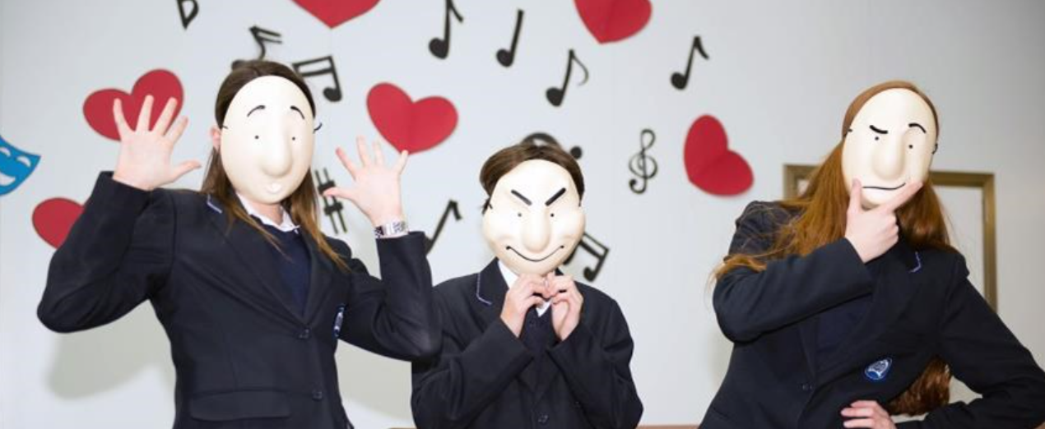
Co-curricular -
Each half term, students will have an option to choose from a variety of co-curricular activities. Co-curricular activities take place during lunchtime or after school on Tuesdays and Thursdays. We run a late bus at 4.10pm for those attending after school activities.
Co-curricular options have included:
Football
Netball
Singing
Nature Club
Physics Club
Creative Writing

Slide 25
Questions
Luke Magee – Principal
Matt Buckley– Assistant Principal
Graeme Henderson– Head of Year 7
Chelsea Greenfield- Inclusion officer and Safeguarding
Lydia McCorriston - SENCO
Our school website has a lot of information and is often the first port of call for dates if you are unsure.
If you have any other questions after today, please do not hesitate to contact our school office at office@wyeschool.org.uk or phone 01233 811110.
The school office will pass your information to the correct member of staff.

